Slide 1

Case Study : Enhancing the User Acquisition Journey for IndusInd Bank Credit Cards
Naveen Kumar
Oct 2023

Slide 2
Agenda
Objective
About IndusInd
Opportunity for improvement
Recommendation
for improvement
Takeaways
Presentation Title

Slide 3

OBJECTIVE
Identify improvement areas and deliver actionable recommendations for enhancing the user’s journey to acquire IndusInd Bank Credit Cards.

Slide 4

IndusInd Bank
IndusInd Bank is a universal bank with more than 2.5 crore customers, over 5,000 distribution points, and approximately 2,000 branches throughout the country.
The bank offers a comprehensive range of products and services for individuals and corporations. IndusInd Bank is a preferred banking partner for several government institutions and public sector undertakings.

Slide 5
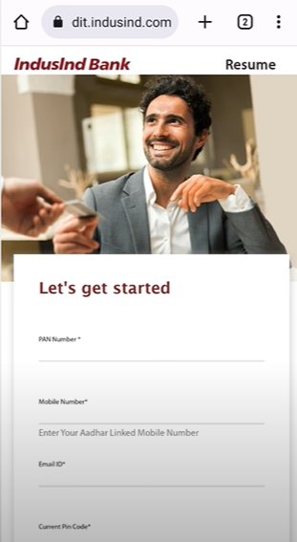
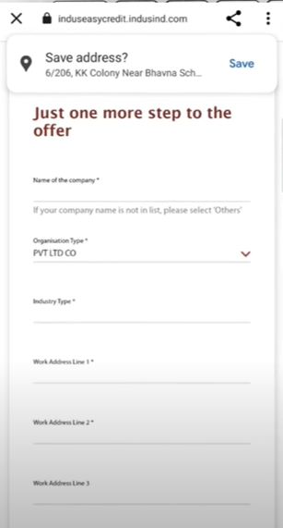
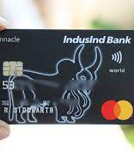
User Interface

Slide 6



Opportunities of Improvement
SMALL FONT SIZE
Font size of texts like PAN number, Email ID., Mobile number and Current PIN code in the user interface are too small. Similar trend follows in other pages.
MULTIPLE PAGES
Mobile Application has 2 different pages for the personal Information of the user.
UNNECESSARY DETAILS
Lat page after selecting the card asks for unnecessary information's like marital status that is compulsory to fill. Further it asks for both the parents' name.

Slide 7

Recommendation for Improvements
Visually pleasing platform for customers
Minimum navigation from one page to another
Keeping extra information optional
Visually pleasing user interface with proper font sizes will help in enhancing the user experience.
Minimum number of pages will help user to spend less time from going one page to another and search for the details.
Unnecessary information if kept optional will help the user to fill the necessary details now and unnecessary details later.

Slide 8


Takeaways
Indian financial services provider IndusInd Bank Limited. The bank strives to be client-focused, working with customers to provide solutions for their banking needs. Three adjustments need to be made to improve the user experience for IndusInd Bank Credit Cards:
Appropriate font size
Combining multiple pages used for single purpose
Making extra information optional

Slide 9
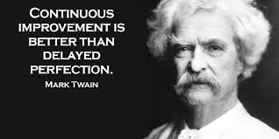

Slide 10




Thank you

